Slide 1

Health Monitor System with PPG and ECG Signal Using IoT
Group Members
ID | Name
1706045 | Mahfuzul
1706066 | Awsaf
1706070 | Azfer
1706081 | Arefin
1706095 | Tahsin
1706103 | Sayonto
1706105 | Mion

Slide 2
Health Monitor System with PPG and ECG Signal Using IoT
Milestones
On Device BPM and SpO2 calculation and display it on LCD monitor :
Beat Per Minute (BPM) and Oxygen Saturation (SpO2) calculation from PPG Signal
Beat Per Minute (BPM) calculation form ECG signal
Real-Time PPG, ECG, BPM monitor using IoT Cloud

Slide 3
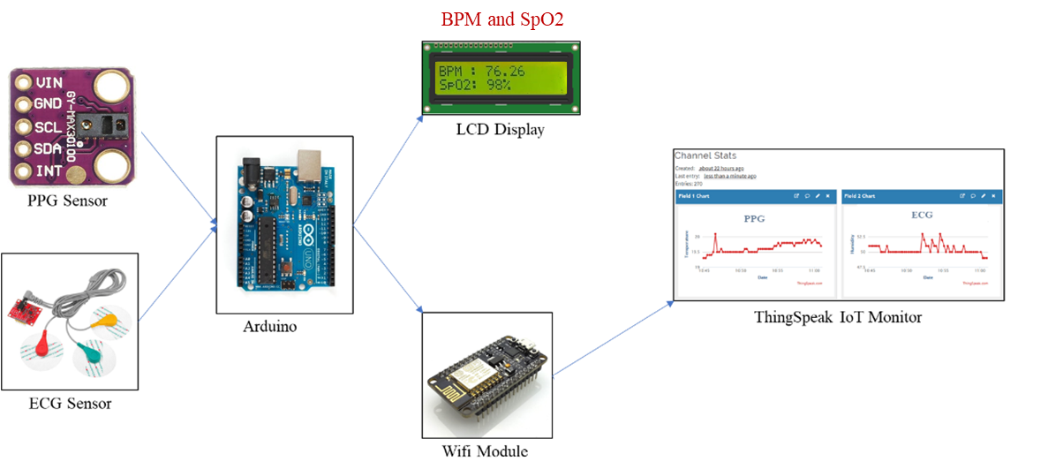
Health Monitor System with PPG and ECG Signal Using IoT
Block Diagram

Slide 4
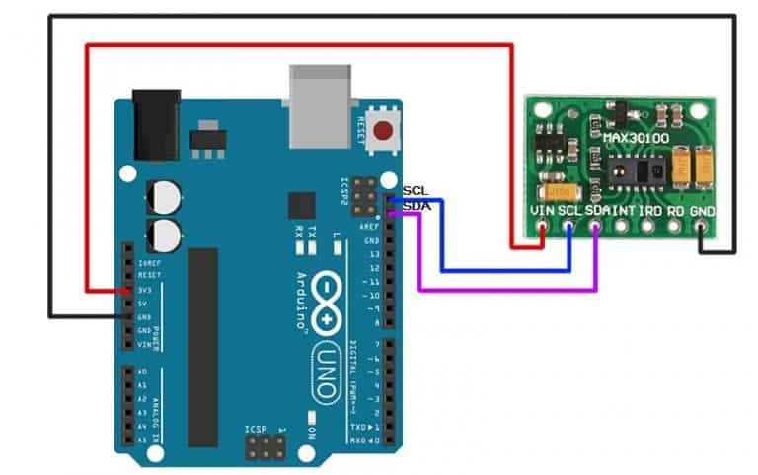
Health Monitor System with PPG and ECG Signal Using IoT
Milestone 1 – Part a: Beat Per Minute (BPM) and Oxygen Saturation (SpO2) calculation from PPG Signal
Circuit Diagram

Slide 5
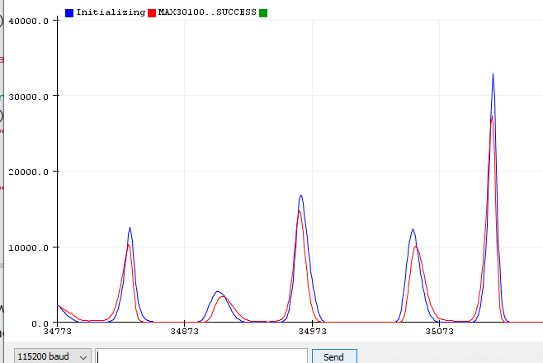
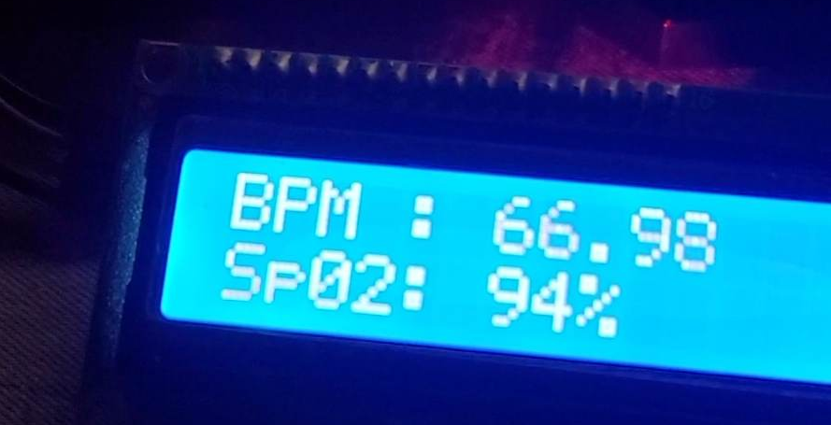
Health Monitor System with PPG and ECG Signal Using IoT
Milestone 1 – Part a: Beat Per Minute (BPM) and Oxygen Saturation (SpO2) calculation from PPG Signal
Outputs
PPG Signal
BPM and SpO2

Slide 6
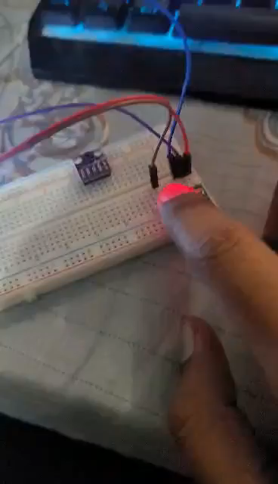
Health Monitor System with PPG and ECG Signal Using IoT
Milestone 1 – Part a: Beat Per Minute (BPM) and Oxygen Saturation (SpO2) calculation from PPG Signal
Demonstrations

Slide 7
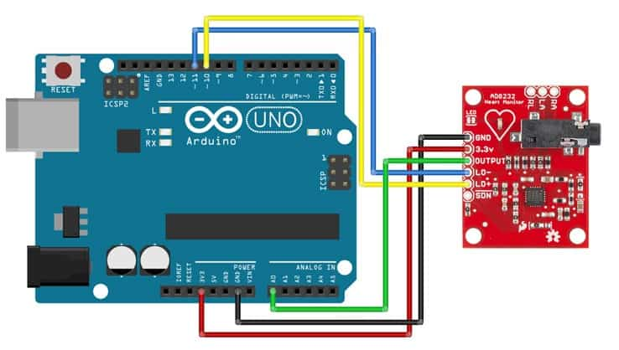
Health Monitor System with PPG and ECG Signal Using IoT
Milestone 1 – Part b: Beat Per Minute (BPM) calculation from ECG Signal
Circuit Diagram

Slide 8
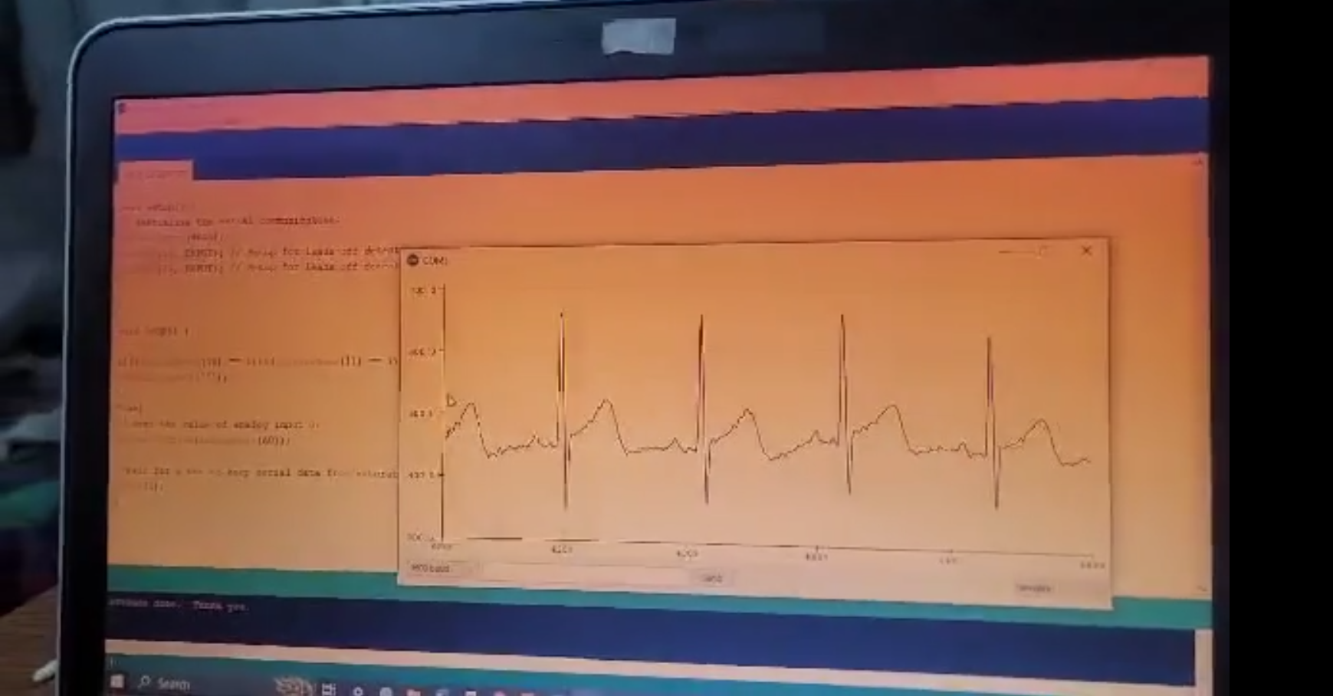
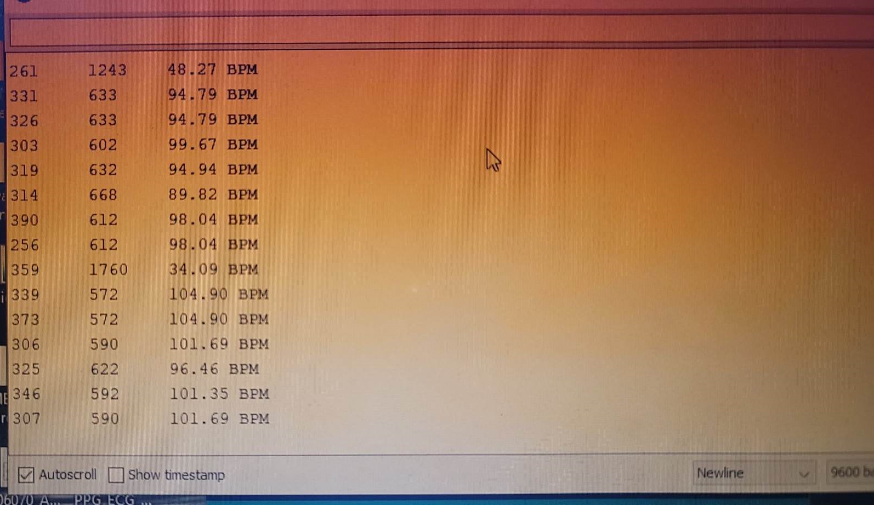
Health Monitor System with PPG and ECG Signal Using IoT
Milestone 1 – Part b: Beat Per Minute (BPM) calculation from ECG Signal
Outputs
ECG Signal
BPM

Slide 9
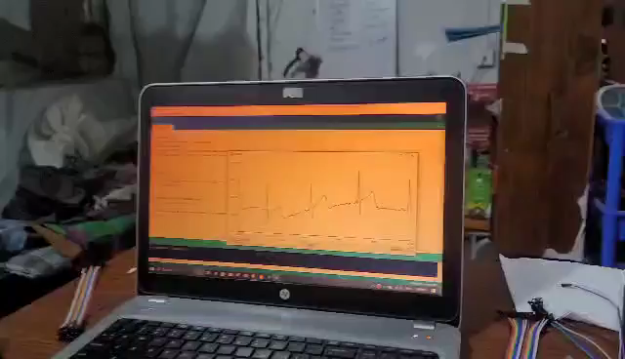
Health Monitor System with PPG and ECG Signal Using IoT
Milestone 1 – Part b: Beat Per Minute (BPM) calculation from ECG Signal
Demonstration - 1

Slide 10
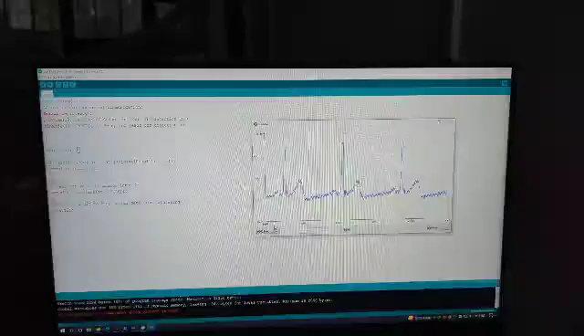
Health Monitor System with PPG and ECG Signal Using IoT
Milestone 1 – Part b: Beat Per Minute (BPM) calculation from ECG Signal
Demonstration - 2

